Slide 1




Critical Thinking S1 2023
Tutor: Dr. Iwan Williams
Email: iwan.williams1@monash.edu

Slide 2
Lecture 7.1
Inferences from a sample

Slide 3
Review quiz!

Slide 4
Two types of support
To say that premises support a conclusion means that:
If the premises were true, then we’d have a good reason to accept the conclusion.
DEDUCTIVE SUPPORT (VALIDITY): If the premise were true, the conclusion must be true.
P1. I can’t answer your emails until I’ve had coffee.
P2. I haven’t had any coffee yet.
Therefore,
C. I can’t answer your emails yet.
INDUCTIVE SUPPORT : If the premise were true, the conclusion would be very likely to be true.
P1. Every time I ordered food at this restaurant in the past it has come out cold.
P2. I just ordered food at this restaurant.
Therefore,
C. The food I ordered will come out cold.

Slide 5
Universal Generalization
Statistical Generalization
… a claim that says something about all things of a certain kind.
All ravens are black.
Everyone in my class likes ice-cream.
… a claim that says something about some number things of a certain kind.
90% of nurses are women.
Only a minority of voters now support the president.
Evidence for/against?:
Counter examples
Inference to the best explanation
Evidence for/against?:
Inference from a sample
Notes:
Arguments that rely on statistical generalisations are used in a wide variety of contexts, from quality control, opinion polls and scientific evidence, to everyday reasoning about a person’s personality.
A common type of argument is one where the conclusion is a statistical generalization based on a sample of cases.

Slide 6
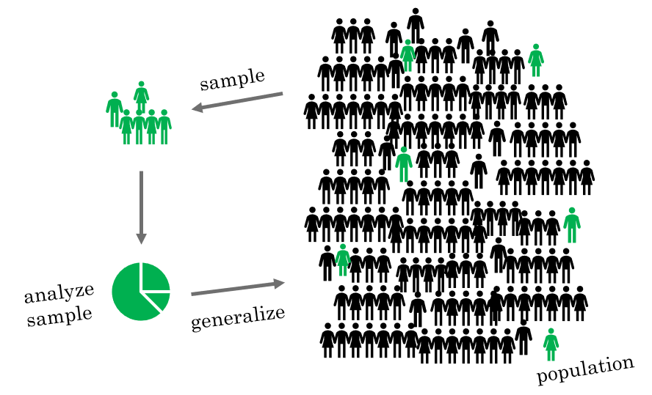
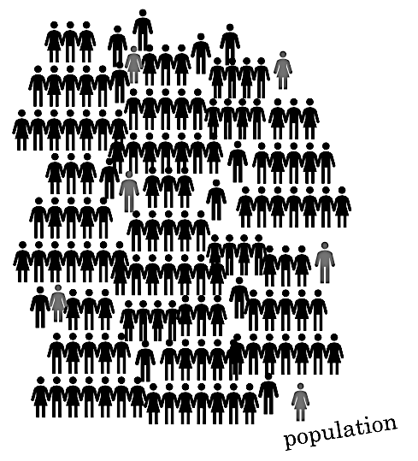

Identifying populations, samples and target properties
12 out of 16 people I asked in downtown LA think that Arnold Schwarzenegger was a bad governor, so roughly 75% of Los Angeles’ population thinks that Schwarzenegger was a bad governor.

Slide 7
Identifying populations, samples and target properties
Population:
The entire group (of cases or individuals) that you wish to draw a conclusion about.
Sample:
The subset of the population that is actually examined (to see whether they have the target property).
Target property:
The feature of the population you are interested in.

Slide 8
Identifying populations, samples and target properties
Population:
The entire group (of cases or individuals) that you wish to draw a conclusion about.
Sample:
The subset of the population that is actually examined (to see whether they have the target property).
Target property:
The feature of the population you are interested in.
12 out of 16 people I asked in downtown LA think that Arnold Schwarzenegger was a bad governor, so roughly 75% of Los Angeles’ population thinks that Schwarzenegger was a bad governor.

Slide 9
Identifying populations, samples and target properties
Population:
The entire group (of cases or individuals) that you wish to draw a conclusion about.
Sample:
The subset of the population that is actually examined (to see whether they have the target property).
Target property:
The feature of the population you are interested in.
12 out of 16 people I asked in downtown LA think that Arnold Schwarzenegger was a bad governor, so roughly 75% of Los Angeles’ population thinks that Schwarzenegger was a bad governor.

Slide 10
Identifying populations, samples and target properties
Population:
The entire group (of cases or individuals) that you wish to draw a conclusion about.
Sample:
The subset of the population that is actually examined (to see whether they have the target property).
Target property:
The feature of the population you are interested in.
12 out of 16 people I asked in downtown LA think that Arnold Schwarzenegger was a bad governor, so roughly 75% of Los Angeles’ population thinks that Schwarzenegger was a bad governor.

Slide 11
Identifying populations, samples and target properties
Population:
The entire group (of cases or individuals) that you wish to draw a conclusion about.
Sample:
The subset of the population that is actually examined (to see whether they have the target property).
Target property:
The feature of the population you are interested in.
12 out of 16 people I asked in downtown LA think that Arnold Schwarzenegger was a bad governor, so roughly 75% of Los Angeles’ population thinks that Schwarzenegger was a bad governor.

Slide 12
Example:
1. X% of members of the sample have the target property.
2. (The sample is representative of the population.)
Therefore,
C: X% of the population have the target property.
Sample: The 50 selected iPads
Target Property: Being faulty
Population: All iPads made at this factory.
A random sample of 50 iPads was selected from the production line of this factory. 10 of them were found to be faulty. So probably, about 20% of the iPads made at this factory are faulty.
Notes:
Quiz!! What is the population?

Slide 13
Example:
1. X% of members of the sample have the target property.
2. (The sample is representative of the population.)
Therefore,
C: X% of the population have the target property.
Sample: The 50 selected iPads
Target Property: Being faulty
Population: All iPads made at this factory.
A random sample of 50 iPads was selected from the production line of this factory. 10 of them were found to be faulty. So probably, about 20% of the iPads made at this factory are faulty.

Slide 14
Example:
1. X% of members of the sample have the target property.
2. (The sample is representative of the population.)
Therefore,
C: X% of the population have the target property.
Sample: The 50 selected iPads
Target Property: Being faulty
Population: All iPads made at this factory.
A random sample of 50 iPads was selected from the production line of this factory. 10 of them were found to be faulty. So probably, about 20% of the iPads made at this factory are faulty.
The population (and the sample) don’t need to consist of people. It can be any group of things, cases, individuals.

Slide 15
Example:
1. X% of members of the sample have the target property.
2. (The sample is representative of the population.)
Therefore,
C: X% of the population have the target property.
Sample: The 50 randomly selected iPads
Target Property: Being faulty
Population: All iPads made at this factory.
A random sample of 50 iPads was selected from the production line of this factory. 10 of them were found to be faulty. So probably, about 20% of the iPads made at this factory are faulty.

Slide 16
Inferences from a sample as arguments
Another
statistical generalisation!
A random sample of 50 iPads was selected from the production line of this factory. 10 of them were found to be faulty. So probably, about 20% of the iPads made at this factory are faulty.
P1. 20% of the 50 selected iPads are faulty.
A2. The 50 selected iPads are representative of all iPads made at this factory.
Therefore,
C. 20% of all iPads made at this factory are faulty.
Statistical generalisation!
Notes:
Assumption is needed because if the sample happened to be sitting under a leaky roof while they were waiting to be tested, we couldn’t draw conclusions about the whole population.

Slide 17
Inferences from a sample as arguments
P1. X% of members of the sample have the target property.
A2. The sample is representative of the population.
Therefore,
C. X% of the population have the target property.
Inductive support
Notes:
For a sample to be representative is for it to be typical or reflective of the group at large.
In other words, when a sample is representative of a population, the distribution of the target property in the sample should be similar to the distribution of the target property in the whole population.
We’ll look at how to distinguish representative from non-representative samples in the next video.

Slide 18
Summary
A kind of inductive argument
(Inductive support: If the premises are true then the conclusion is likely to be true).
P1. X% of members of the sample have the target property.
A2. The sample is representative of the population.
Therefore,
C. X% of the population have the target property.
AT4 Q1 and a question on your exam will describe an inference from a sample ask you to…
Identify the sample, population and target property.
Evaluate whether the evidence provided gives us a good reason to accept the conclusion

Slide 19
Lecture 7.2
Evaluating inferences from a sample

Slide 20
Evaluating inferences from a sample
P1. X% of members of the sample have the target property.
A2. The sample is representative of the population.
Therefore,
C. X% of the population have the target property.
Evaluating inferences from a sample:
Is the sample representative of the population?
Are there problems with how the target property has been measured?

Slide 21
1. Is the sample representative of the population? (i) Is the sample size adequate?
We all know sample size is important.
But why?

Slide 22

Probability of flipping ≥ 60% heads?
Sample size 5 tosses:
50% chance of flipping 3 or more heads
Sample size 10 tosses:
37.7% chance of flipping 6 or more heads
Sample size 20 tosses:
25.17% chance of flipping 12 or more heads.
Sample size 100 tosses:
2.84% chance of flipping 60 or more heads
Sample size 1000 tosses:
~0.000000013% chance of flipping 600 or more heads
Notes:
You’d need about 2 billion attempts at flipping 100 coins before you’d have a good chance of flipping 80 or more heads.

Slide 23
Why sample size matters
The smaller the sample, the more likely it is that your sample will not be representative of the population as a result of statistical chance.

Slide 24
How large is large enough?
It depends on a few factors – there are mathematical procedures for calculating this, but those won’t concern us here…
It’s not about sampling a certain proportion of the population! In most cases, the size of the population doesn’t matter (so long as your sample is random).
Having a large sample won’t help if:
The sample has been selected in a biased way
The target property has been measured in a biased way
Notes:
This isn’t a stats course
In the questions you'll look at, it will usually be obvious if the sample size is inadequate.
Most importantly is that you understand the points mentioned on this slide.

Slide 25
Evaluating inferences from a sample:
Is the sample representative of the population?
Is the sample size adequate?
Was there selection bias when selecting the sample?
Selection biases are issues with the way that a sample is selected from the population that can make the sample unrepresentative of the population.
Notes:
- “Bias” doesn’t mean that these are deliberate tactics used to deceive others, or in service of some agenda (although in some cases they may be).
- Samples can be selected in a biased way (a way which makes the sample unrepresentative) even if the people selecting the sample are completely unaware of this

Slide 26

Common sources of selection bias
Availability sample:
Sample is selected based on what is readily available, or come to mind easily.
Why does this introduce bias?
Because the available individuals may not be representative of the population as a whole.
Example: W.E.I.R.D. participants in psychology
Self-selected samples:
Participants chose whether or not to participate.
Why does this introduce bias?
Because people with strong (especially negative) opinions are most likely to participate.
Example: SETUs
Notes:
- These are two common sources, but you need to be on the look out for ANY factors which are likely to make your sample unrepresentative of the population (with respect to the target property).
Wealthy Educated Industrialised Rich Developed

Slide 27
Evaluating inferences from a sample:
Is the sample representative of the population?
Is the sample size adequate?
Was there selection bias when selecting the sample?
Are there problems with how the target property has been measured?
Was there a measurement bias?
Measurement biases are issues with the process of measuring the target property which lead to an inaccurate view of how that property is distributed in the sample.

Slide 28
Measurement bias – common sources
Many possible sources of measurement bias!
Faulty equipment, unreliable tests
When the target property is measured by polling human participants:
Inaccuracies in memory
Motivations to lie
E.g. desire to portray oneself positively
“do you have racist attitudes?
Wording of questions
Different wording can encourage participants to think about a question differently
Example:
‘Do you support independence for Scotland?’ (51% yes)
‘Do you support an independent Scotland, separate from the United Kingdom?’ (34% yes)
Notes:
Anything which can get between you and the thing you’re trying to measure.
Think of COVID statistics.

Slide 29
Example
F
In 2000, 60% of Australians preferred beer over coffee. However, a recent study has revealed that attitudes towards alcohol have shifted. In this study, researchers offered free beverages to Christmas shoppers in Rundle Mall between 8am-10am on Sunday 6th of December 2021. Of the 1000 shoppers served, 800 opted for coffee. It seems now that 80% of Australians prefer coffee over beer.
(Fictional example)
1. 80% of the 1000 Rundle Mall shoppers prefer coffee over beer.
2. These 1000 Rundle Mall shoppers are representative of all Australians.
Therefore,
C. 80% of Australians prefer coffee over beer.
Sample:
1000 Christmas shoppers in Rundle Mall who were offered free beverages between 8am-10am.
Target Property:
Preference for coffee over beer.
Population:
All Australians
F

Slide 30
Summary
P1. X% of members of the sample have the target property.
A2. The sample is representative of the population.
Therefore,
C. (It is likely that) X% of the population have the target property.
Ways of questioning premise/assumption 2:
What was the size of the sample?
Is it large enough to support the conclusion?
How was the sample selected?
Could the selection process introduce bias?
Was the sample self-selected or based on memorable or available cases?
Ways of questioning premise 1:
How was the target property measured?
What questions were asked?
Are people likely to respond untruthfully or inaccurately?

